Slide 1
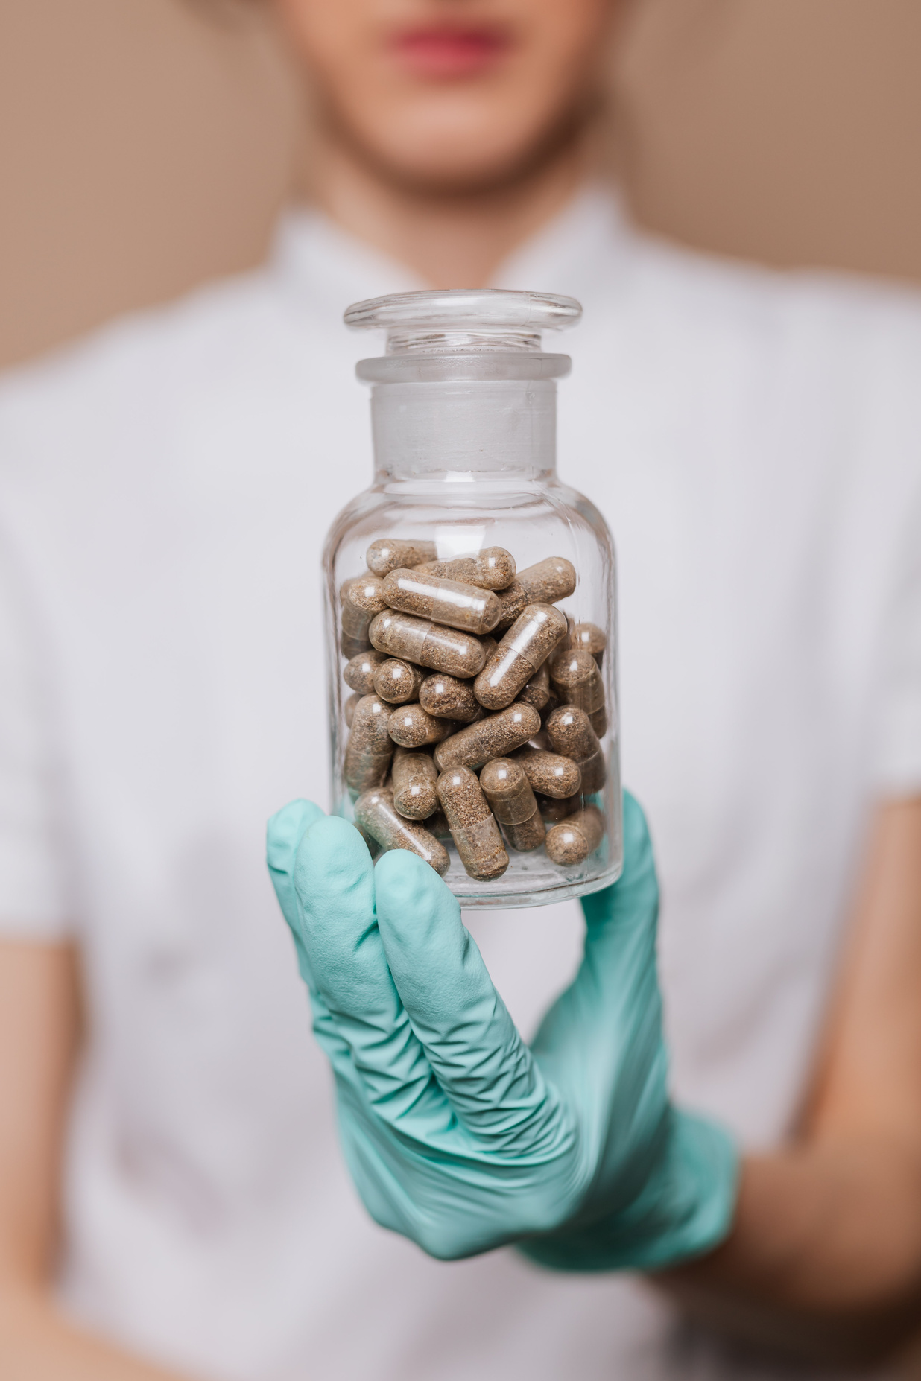

IDCC375 Spring 2024
Pillbox Prototype Research Report ​
Presented by
Harry Chow, Soyoung Park, Kathleen Haddad, Argely Jiminian​

Slide 2


Our Focus
  Regular people that are often away from home
  Frequent commuters/travelers)
  Middle aged men and women​
  Blue-collar + white-collar workers​​
IDCC 375

Slide 3


The Needs
  Discreet
  Compact and portable
  Easily refillable and organizable
  Can hold enough pills for trips
  Easily accessible on the go
  Reminders to take pills when busy
IDCC 375

Slide 4

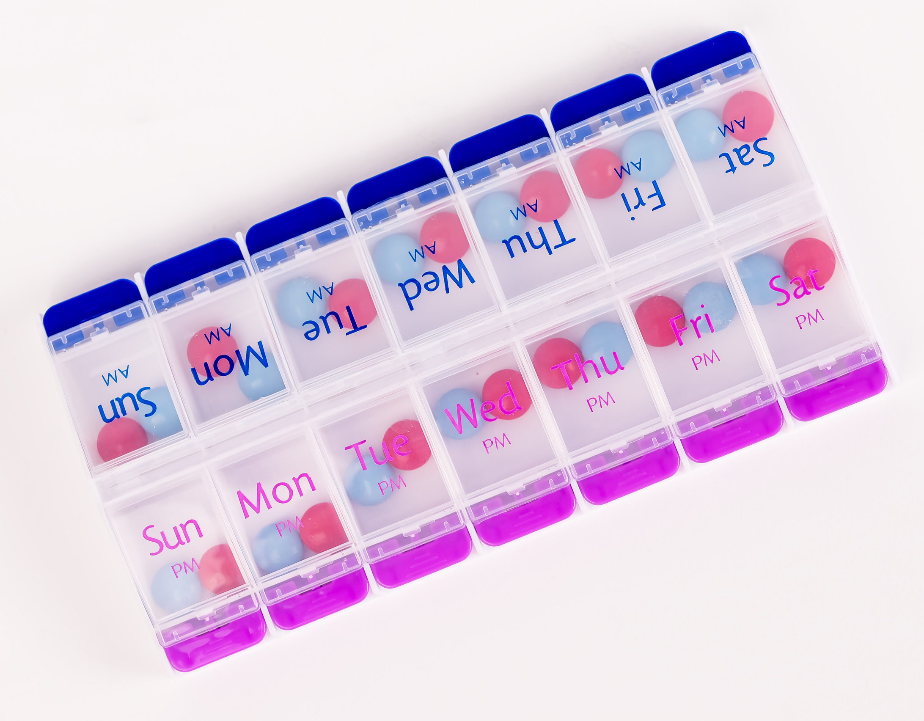
The Problems
  Poor organization ​
    Poor labelling​
    Hard to distinguish between pills​
    Limited sorting options​
  Accessibility
    Hard to open
    Hard to refill ​
    Pills fall out easily ​
  Safety​
    No protection from moisture​
    Bacterial cross-contamination ​
    Not durable ​
    Hard to clean and maintain​
IDCC 375

Slide 5
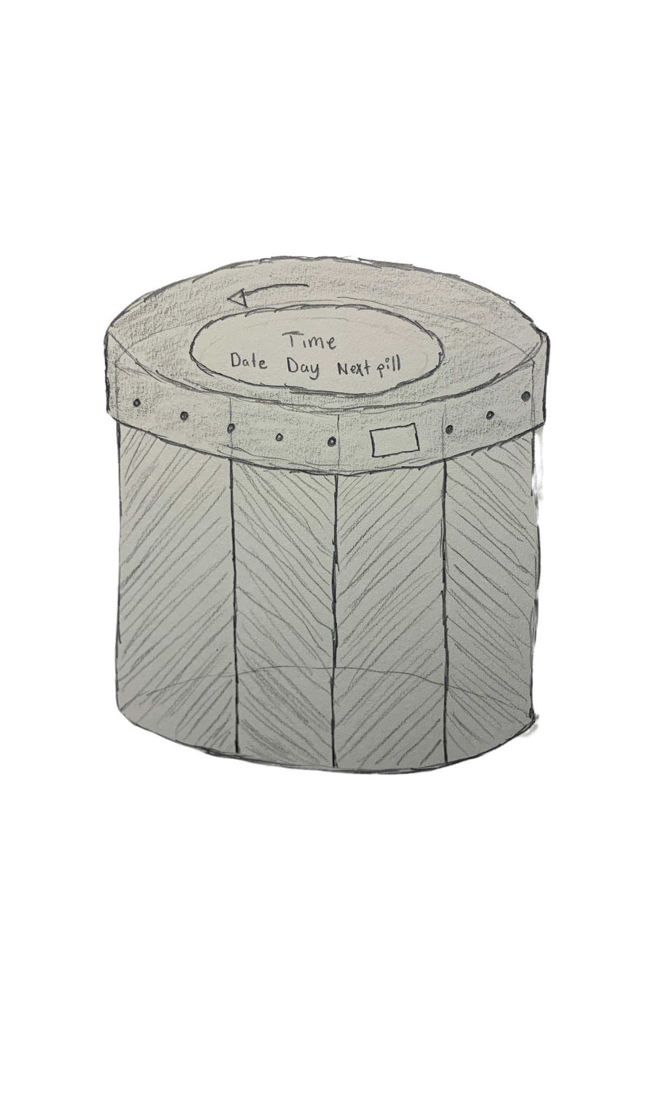
Sketch #1
Griped turnable cap
Screen
Build
Grip, turn, press down, and boila!
Dispenser
Opening
Removable cap, refillable capsules, turning cap.
IDCC 375
Easy to USE
Small allows for portability and storage of pills. Screen sends alarm reminders.
Pill capsule
Pill capsule
Pill capsule
Pill capsule

Slide 6


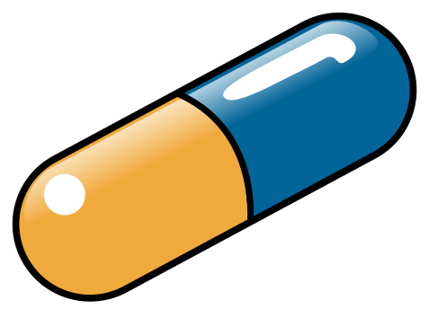
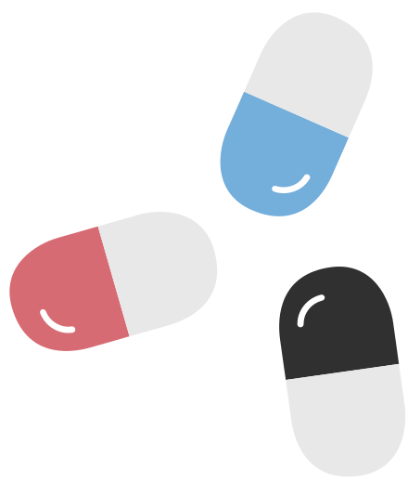
Sketch #2
Build
This container offers a customizable and portable design. Offering easy exchange of pillboxes.
Accessible
Each capsule can hold variety of pills, allowing easy assortment and organization.
IDCC 375
Refillable
Pill boxes can easily be swapped and refilled as needed so individuals on the go can grab what they need.

Slide 7
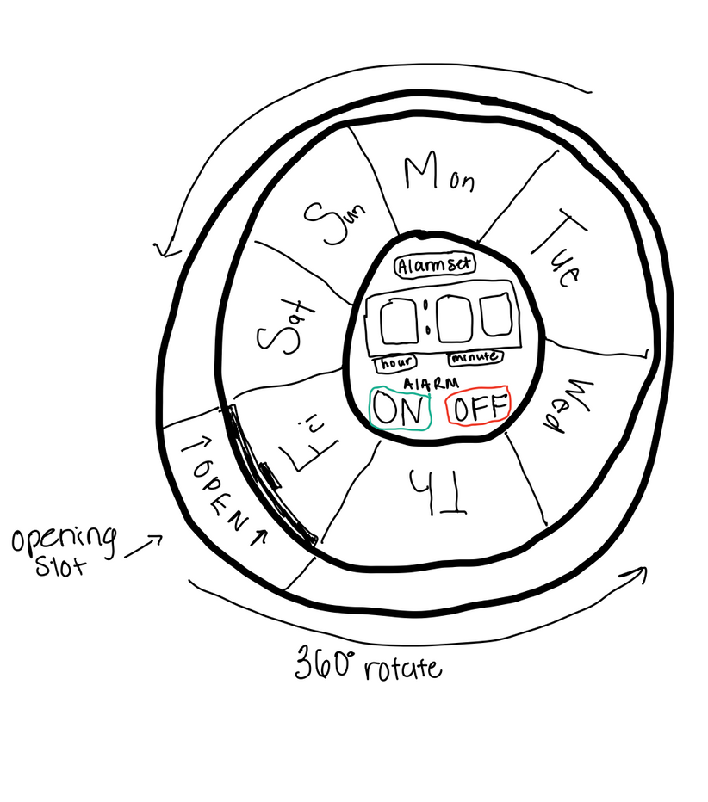
Sketch #3
Build
This container offers a sleek, easy to store capsule holder.
Opening & Roatation
Features one opening tab to minimalize spills during travel. It is less likely to spill out. Features rotating sections for each day of the week. Rotate proper day to opening, pull opening and pour out that days doses.
IDCC 375
Alarm
Center of container features an alarm that you can program and set to any time. It can be reprogrammed an unlimited amount of times and has an on and off button.

Slide 8
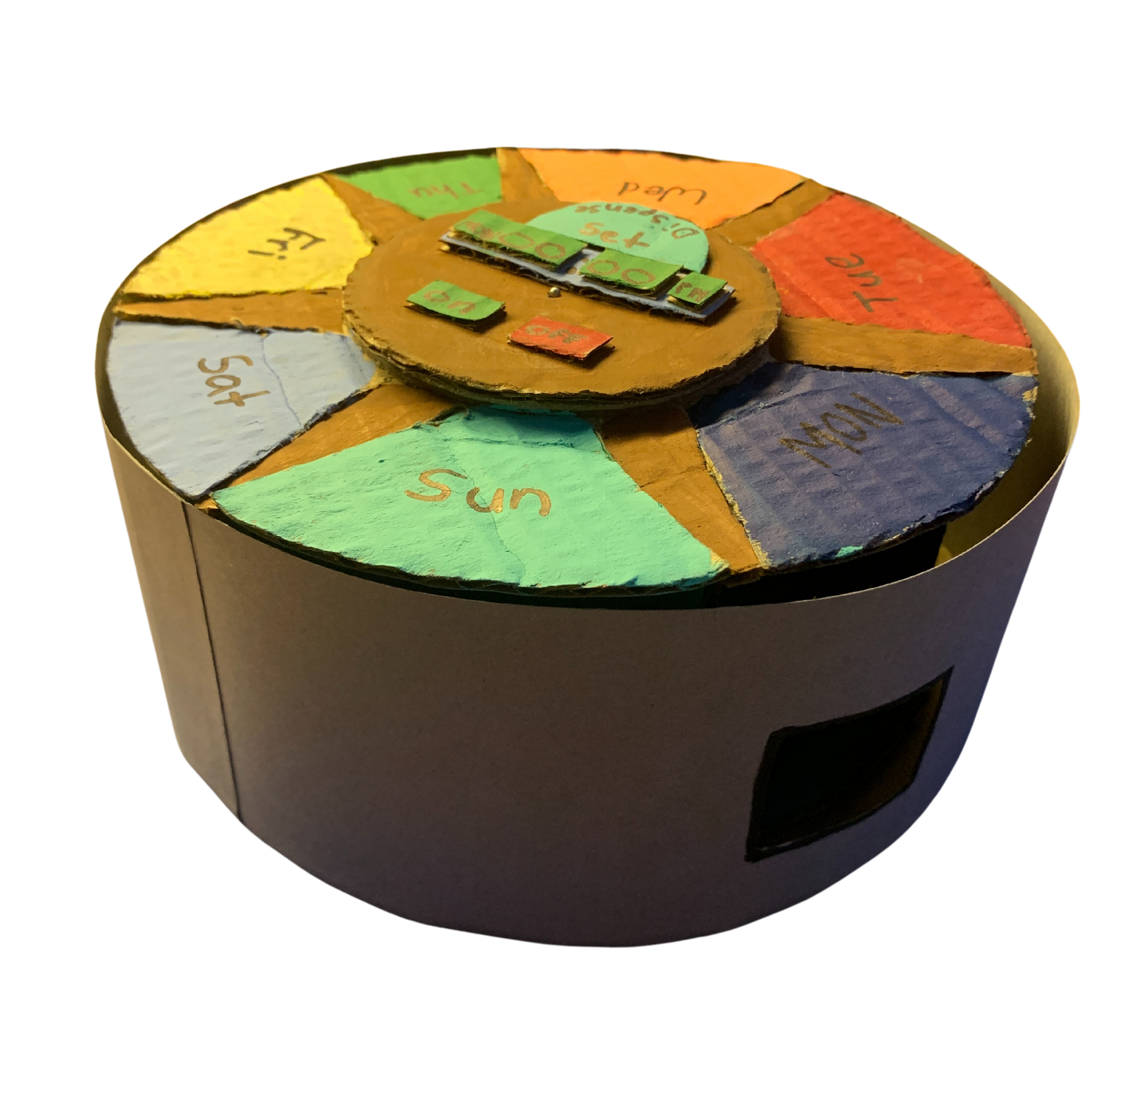
Final Prototype

Slide 9
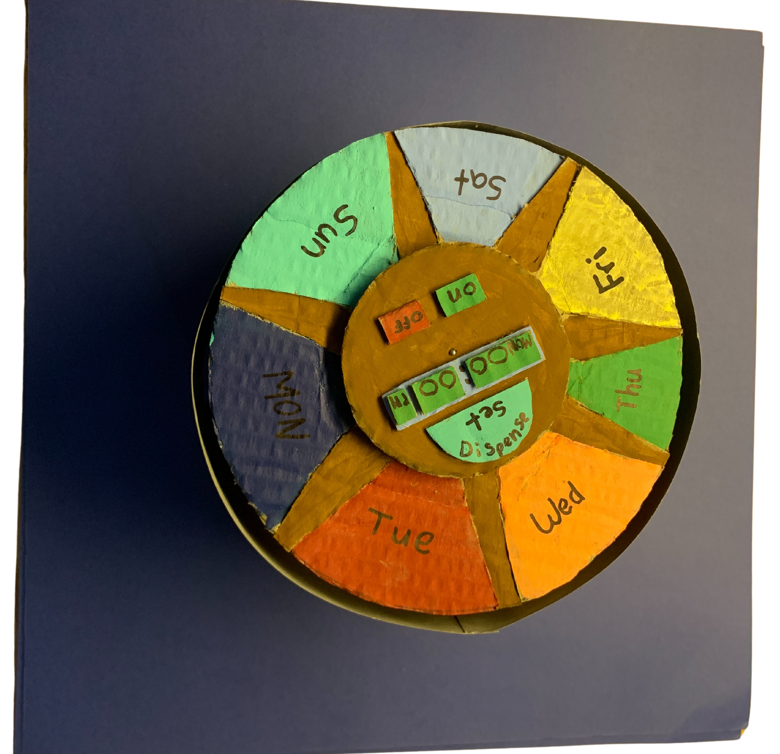
Final Prototype

Slide 10




Needs our Prototype Meets for Travelers/ Justifying our Desicion
It is small and compact. It is easiest to store in a bag or in your pocket when on the go.
It will have multiple color options. So the container will look more like a candy or mint container and will disguise its true pill holding purpose for users who want to be discrete with medications.
It is a secure container with only one opening, rather than each day and time having its own opening. The 360 degree rotation ensures that it will prevent spills and losing medications.
Includes alarm clock which can be set and reset. This way people can avoid the trouble of forgetting to take their medication.

Slide 11
Thank You!
Any questions?
IDCC 375

